Slide 1
Please say the words on the next slide real loud

Slide 2
Welcome to I’m Sure they are doing their best with Paul and Drew Furguielle

Slide 3
SQL Notebooks in Azure Data Studio
for the DBA
Rob Sewell - Sewells Consulting Ltd

Slide 6
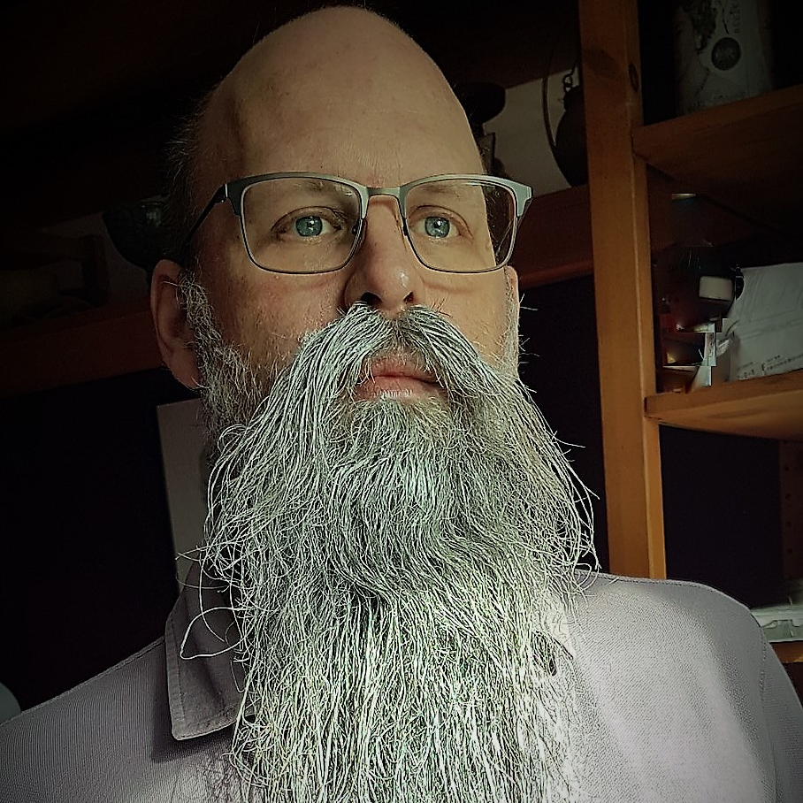
Rob Sewell
Bearded Consultant, Automator,
Trainer
Consultant Sewells Consulting Ltd
beard.media/book dbachecks PowerShell & Data Community
/robsewellsqldba
@sqldbawithbeard
SQLDBAWithABeard.com

Slide 7
What’s Azure Data Studio?

Slide 8
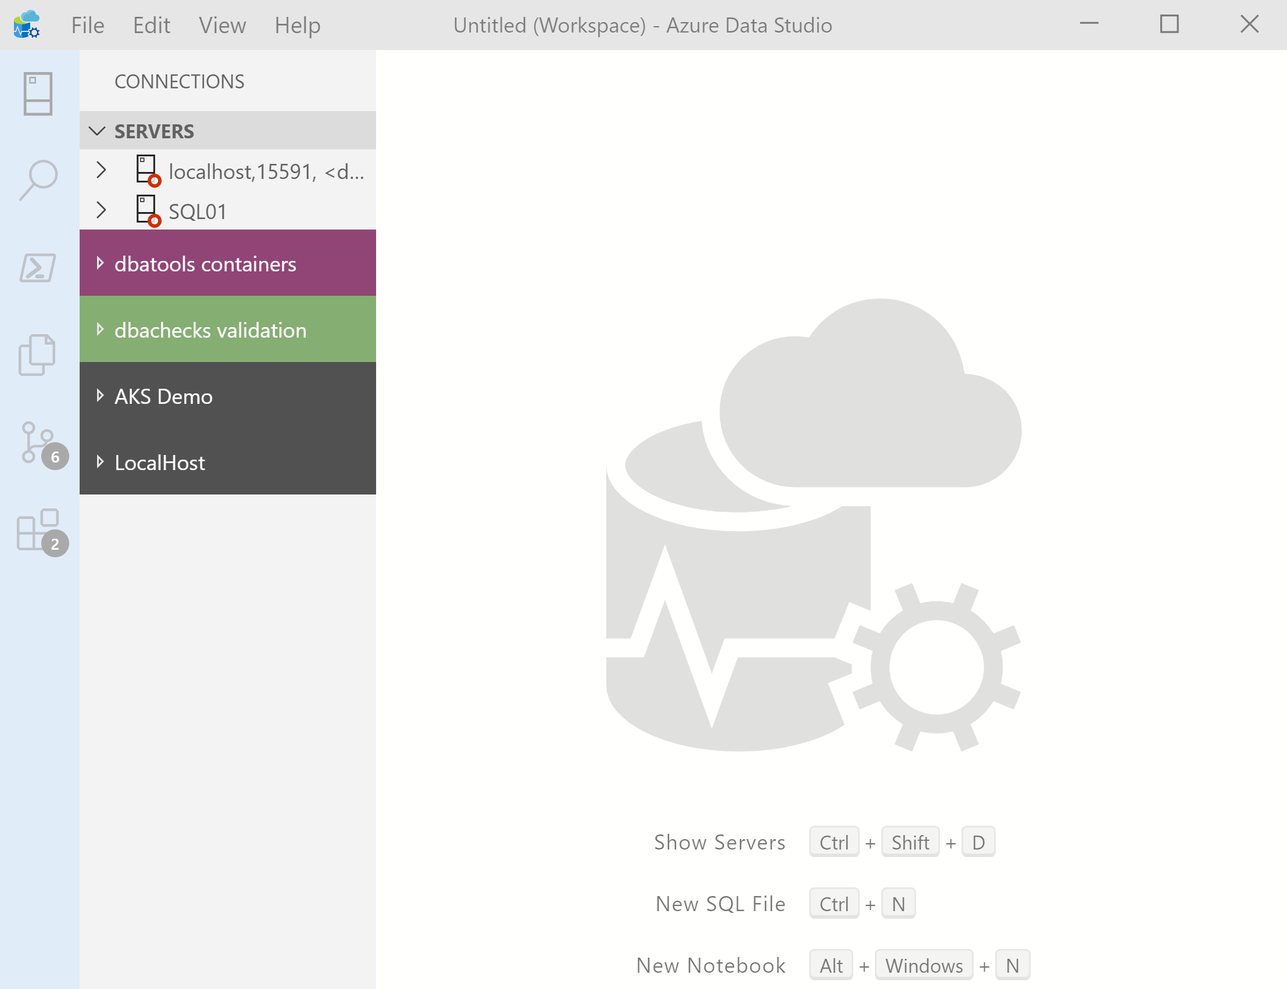
What’s Azure Data Studio ?
Cross Platform desktop environment for Data Professionals

Slide 9

So it’s only for Azure?

Slide 10
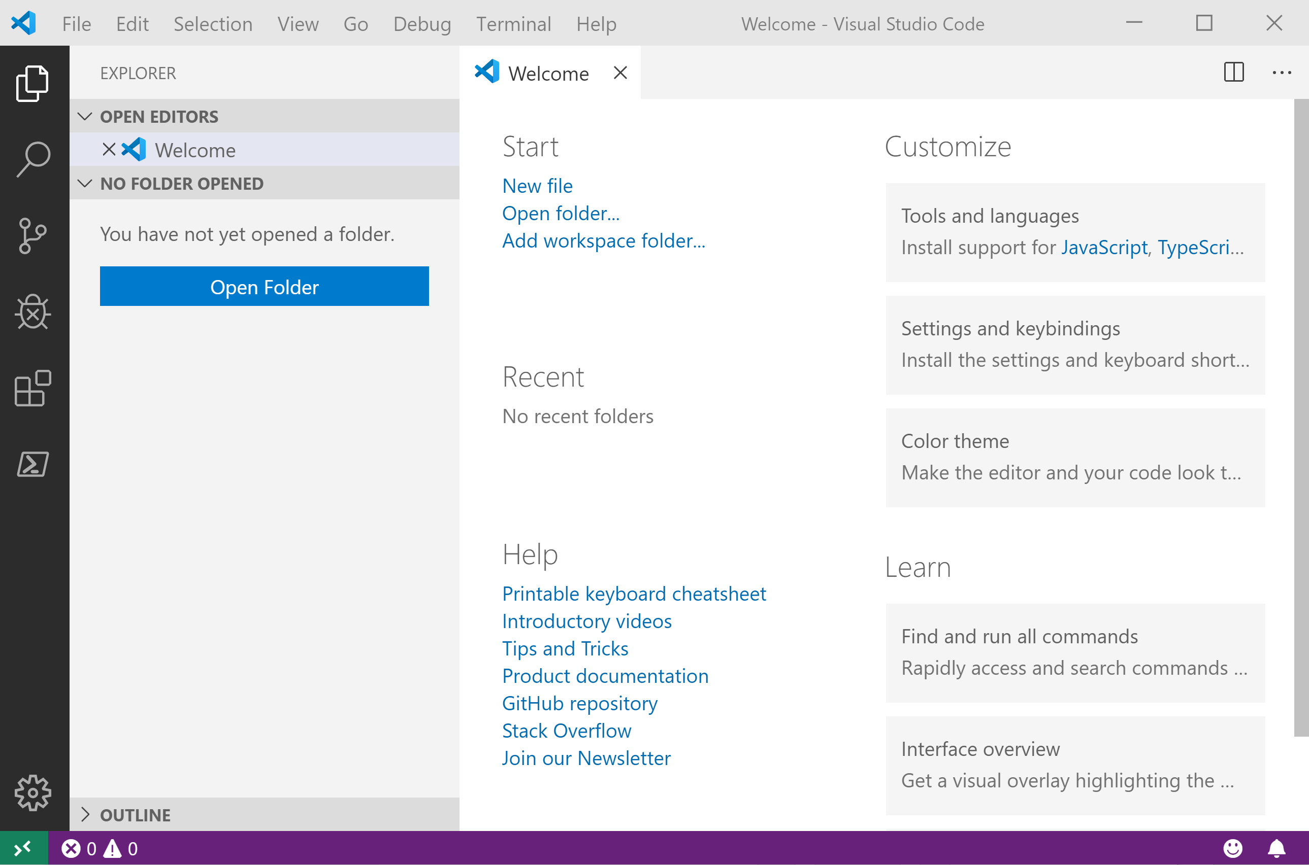
It Looks Like Visual Studio Code ?

Slide 11
It Looks Like Visual Studio Code ?

Slide 12
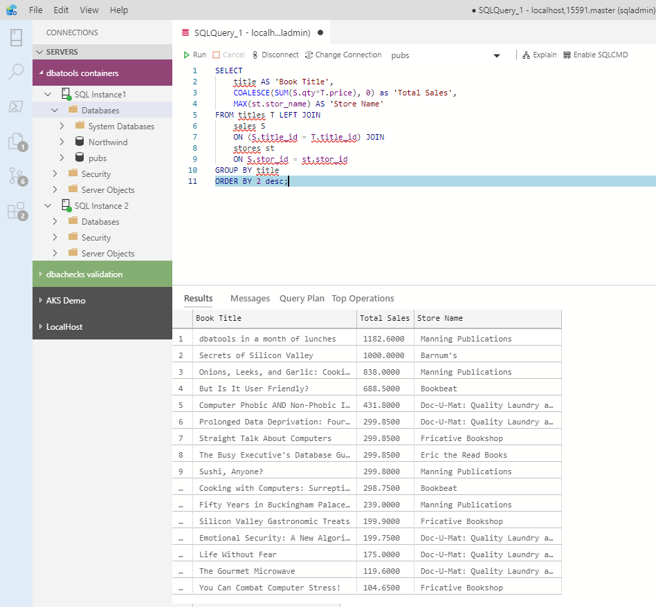
What can you do in Azure Data Studio ?
You can run T-SQL queries!

Slide 13
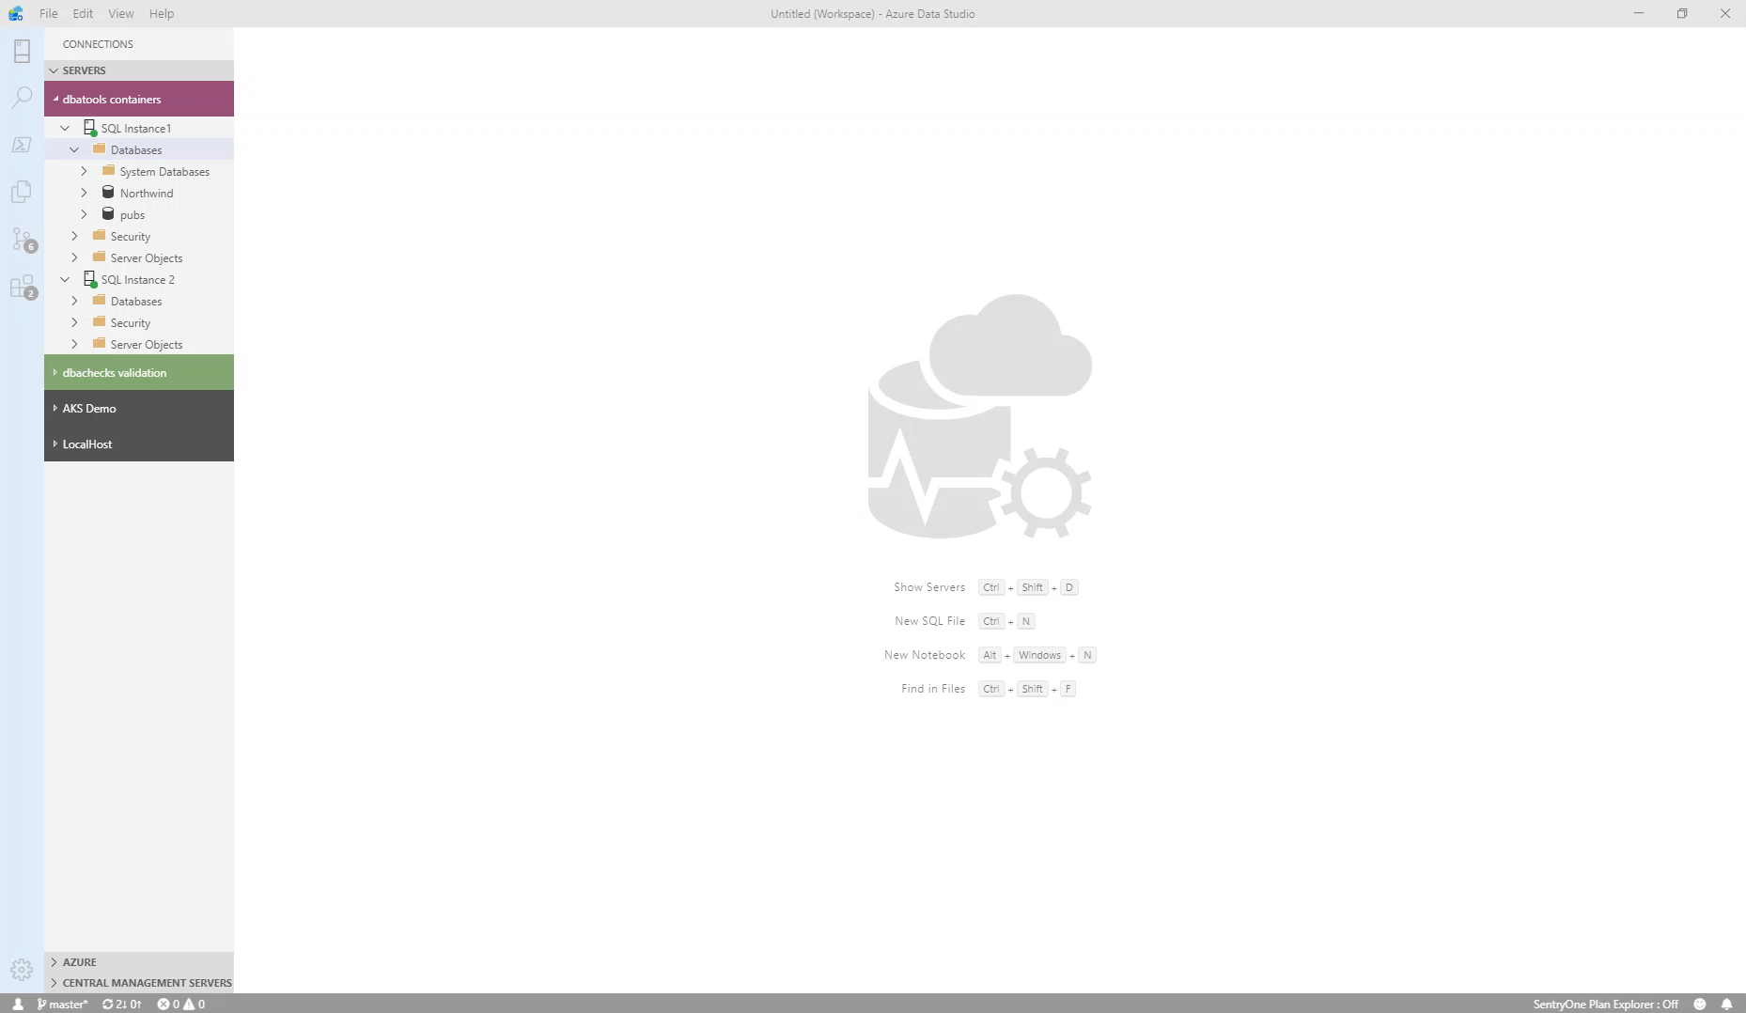
What can you do in Azure Data Studio ?
You can get execution plans

Slide 14
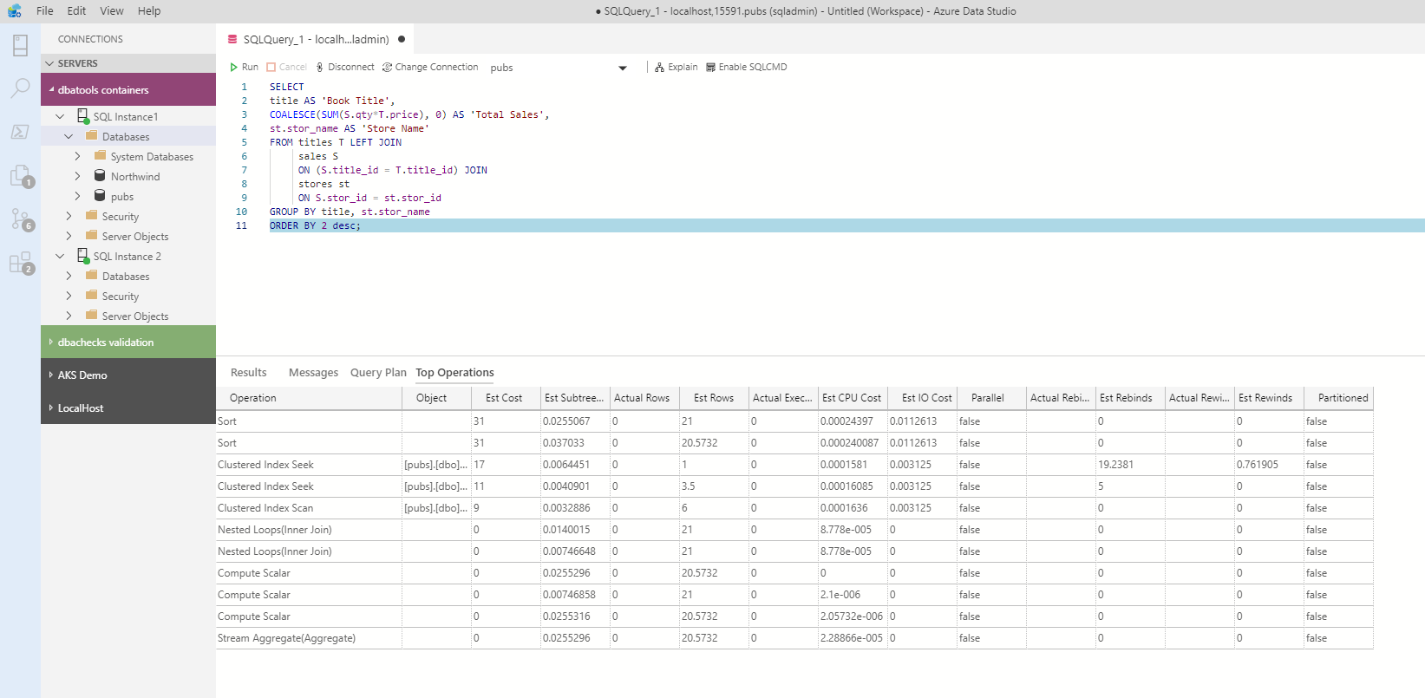
What can you do in Azure Data Studio ?
You can get the top operations

Slide 15
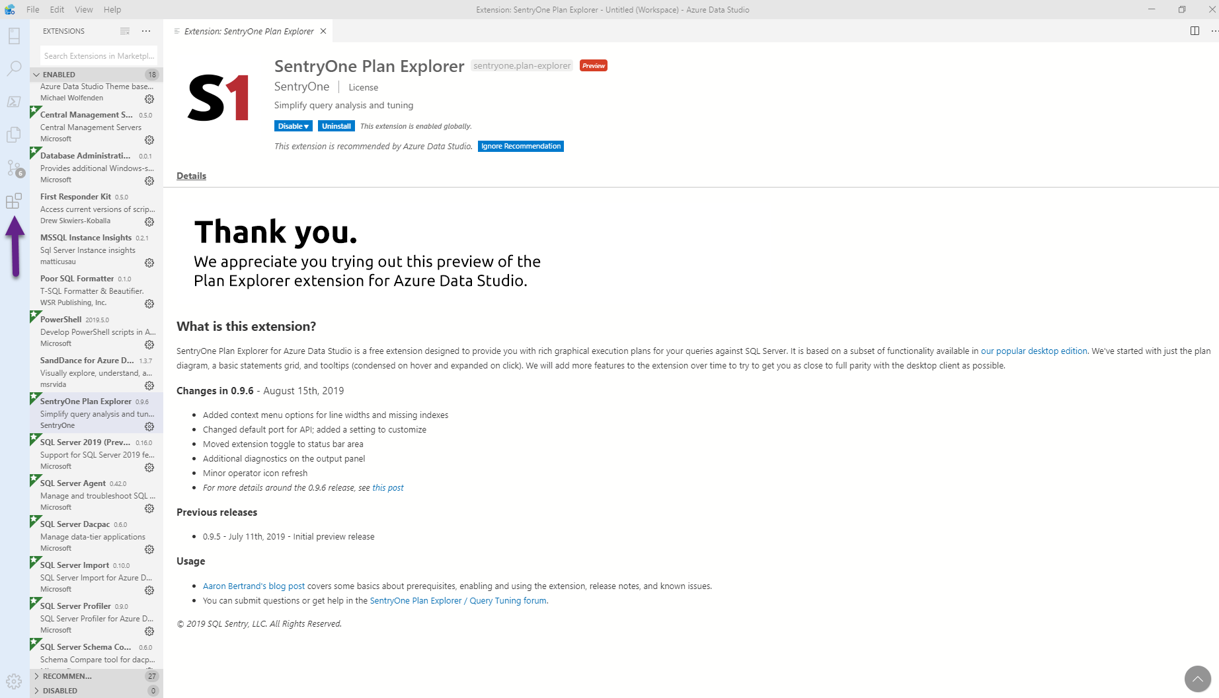
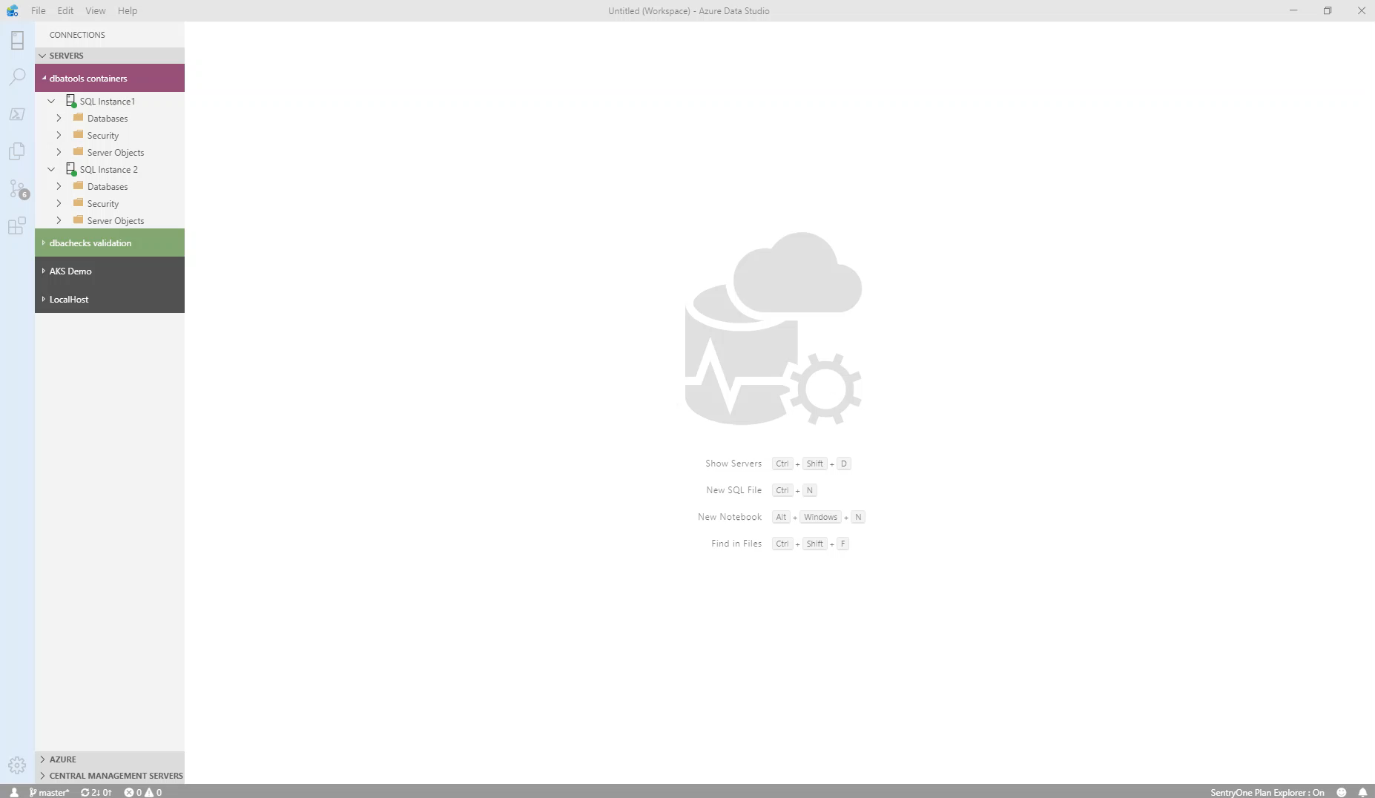
What can you do in Azure Data Studio ?
You can install extensions for more functionality

Slide 16
What can you do in Azure Data Studio ?
And get Plan Explorer

Slide 17
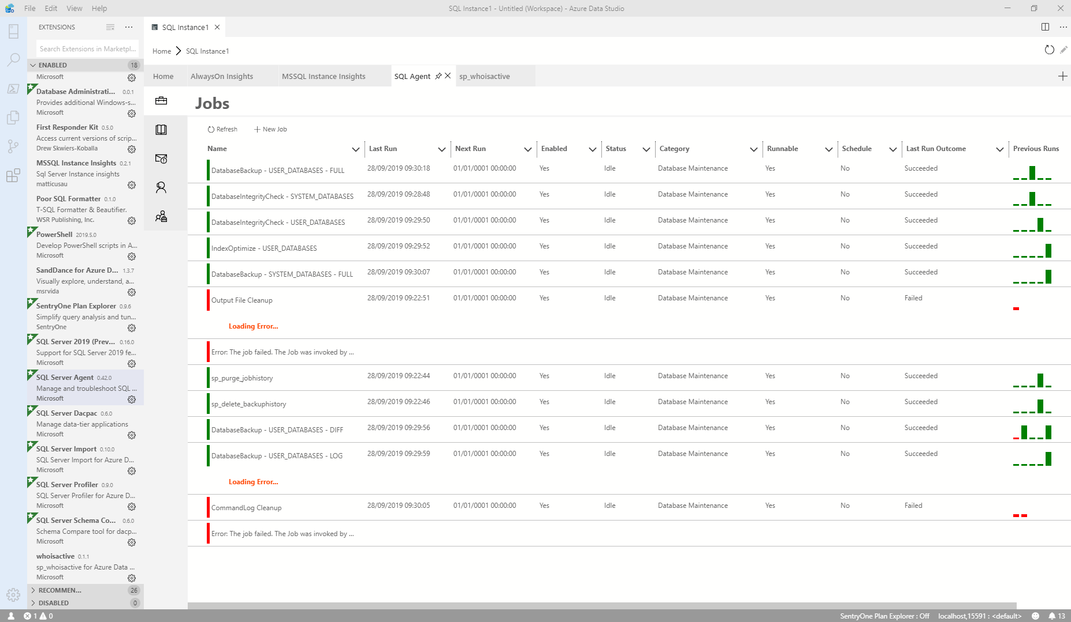
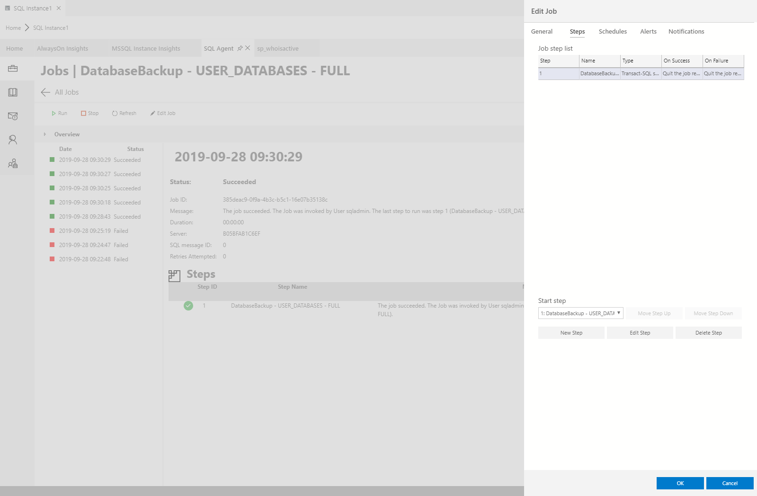
What can you do in Azure Data Studio ?
You can work with SQL Agent Jobs

Slide 18
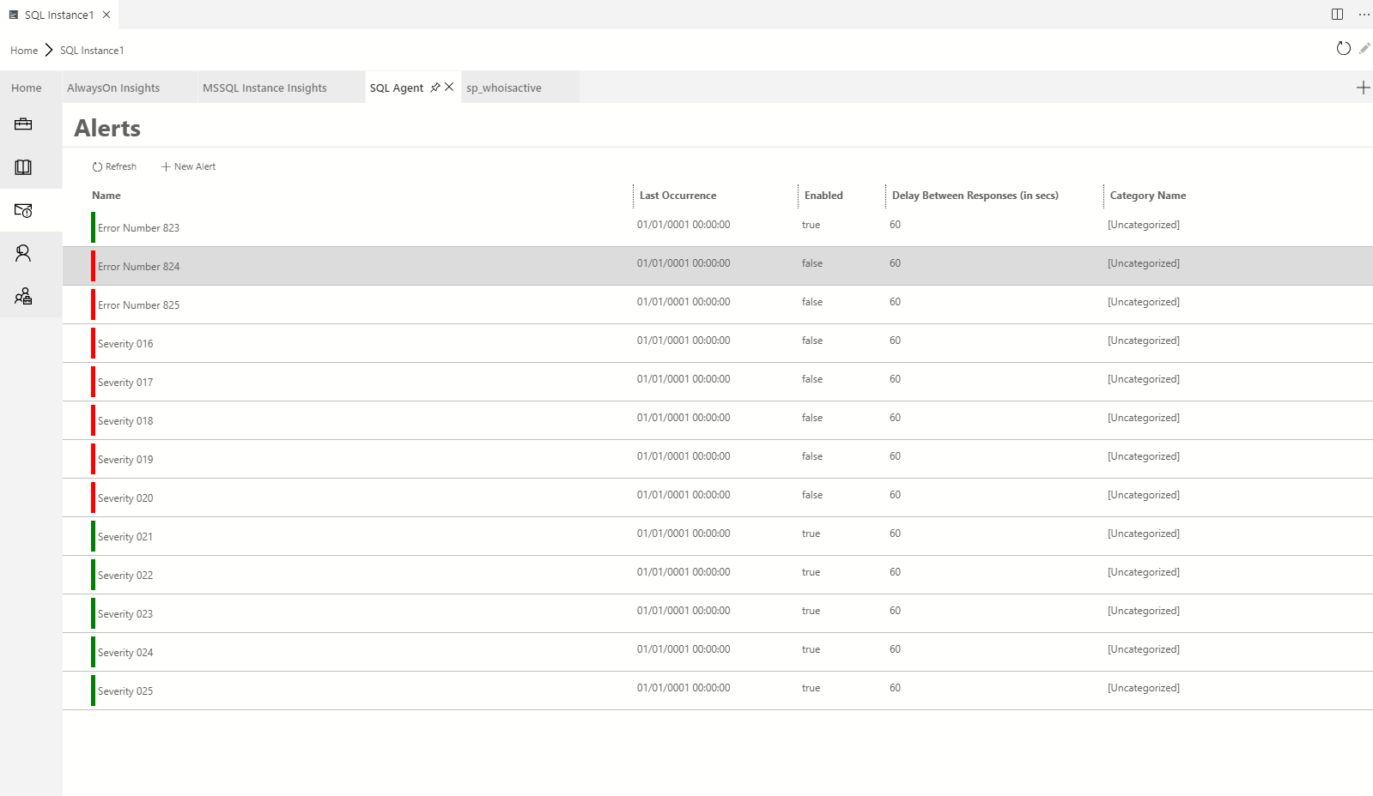
What can you do in Azure Data Studio ?
You can work with SQL Agent Jobs

Slide 19
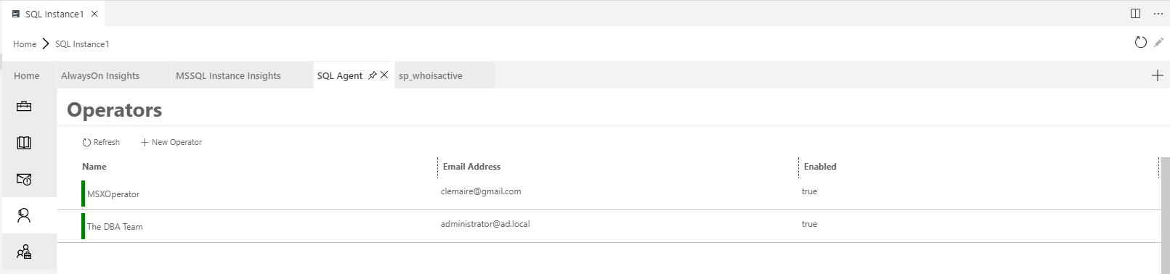
What can you do in Azure Data Studio ?
You can work with Alerts

Slide 20
What can you do in Azure Data Studio ?
You can work with Operators

Slide 21
What can you do in Azure Data Studio ?

Slide 22

What can you do in Azure Data Studio ?

Slide 23
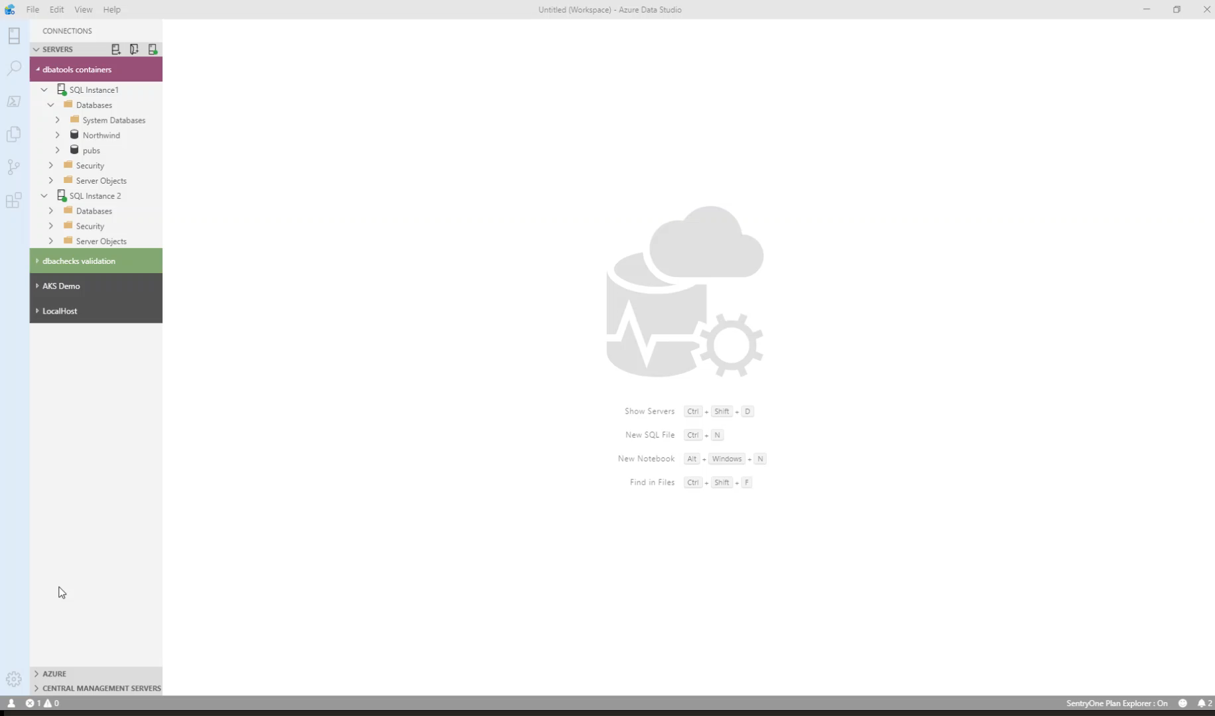
What can you do in Azure Data Studio ?
You can run PowerShell ☺

Slide 24
What’s A SQL Notebook?

Slide 25

What is a SQL Notebook?
Originally for Data Scientists

Slide 26
What is a SQL Notebook?
Document that can contain text, code, images and query results

Slide 27
I’m a DBA

Slide 28
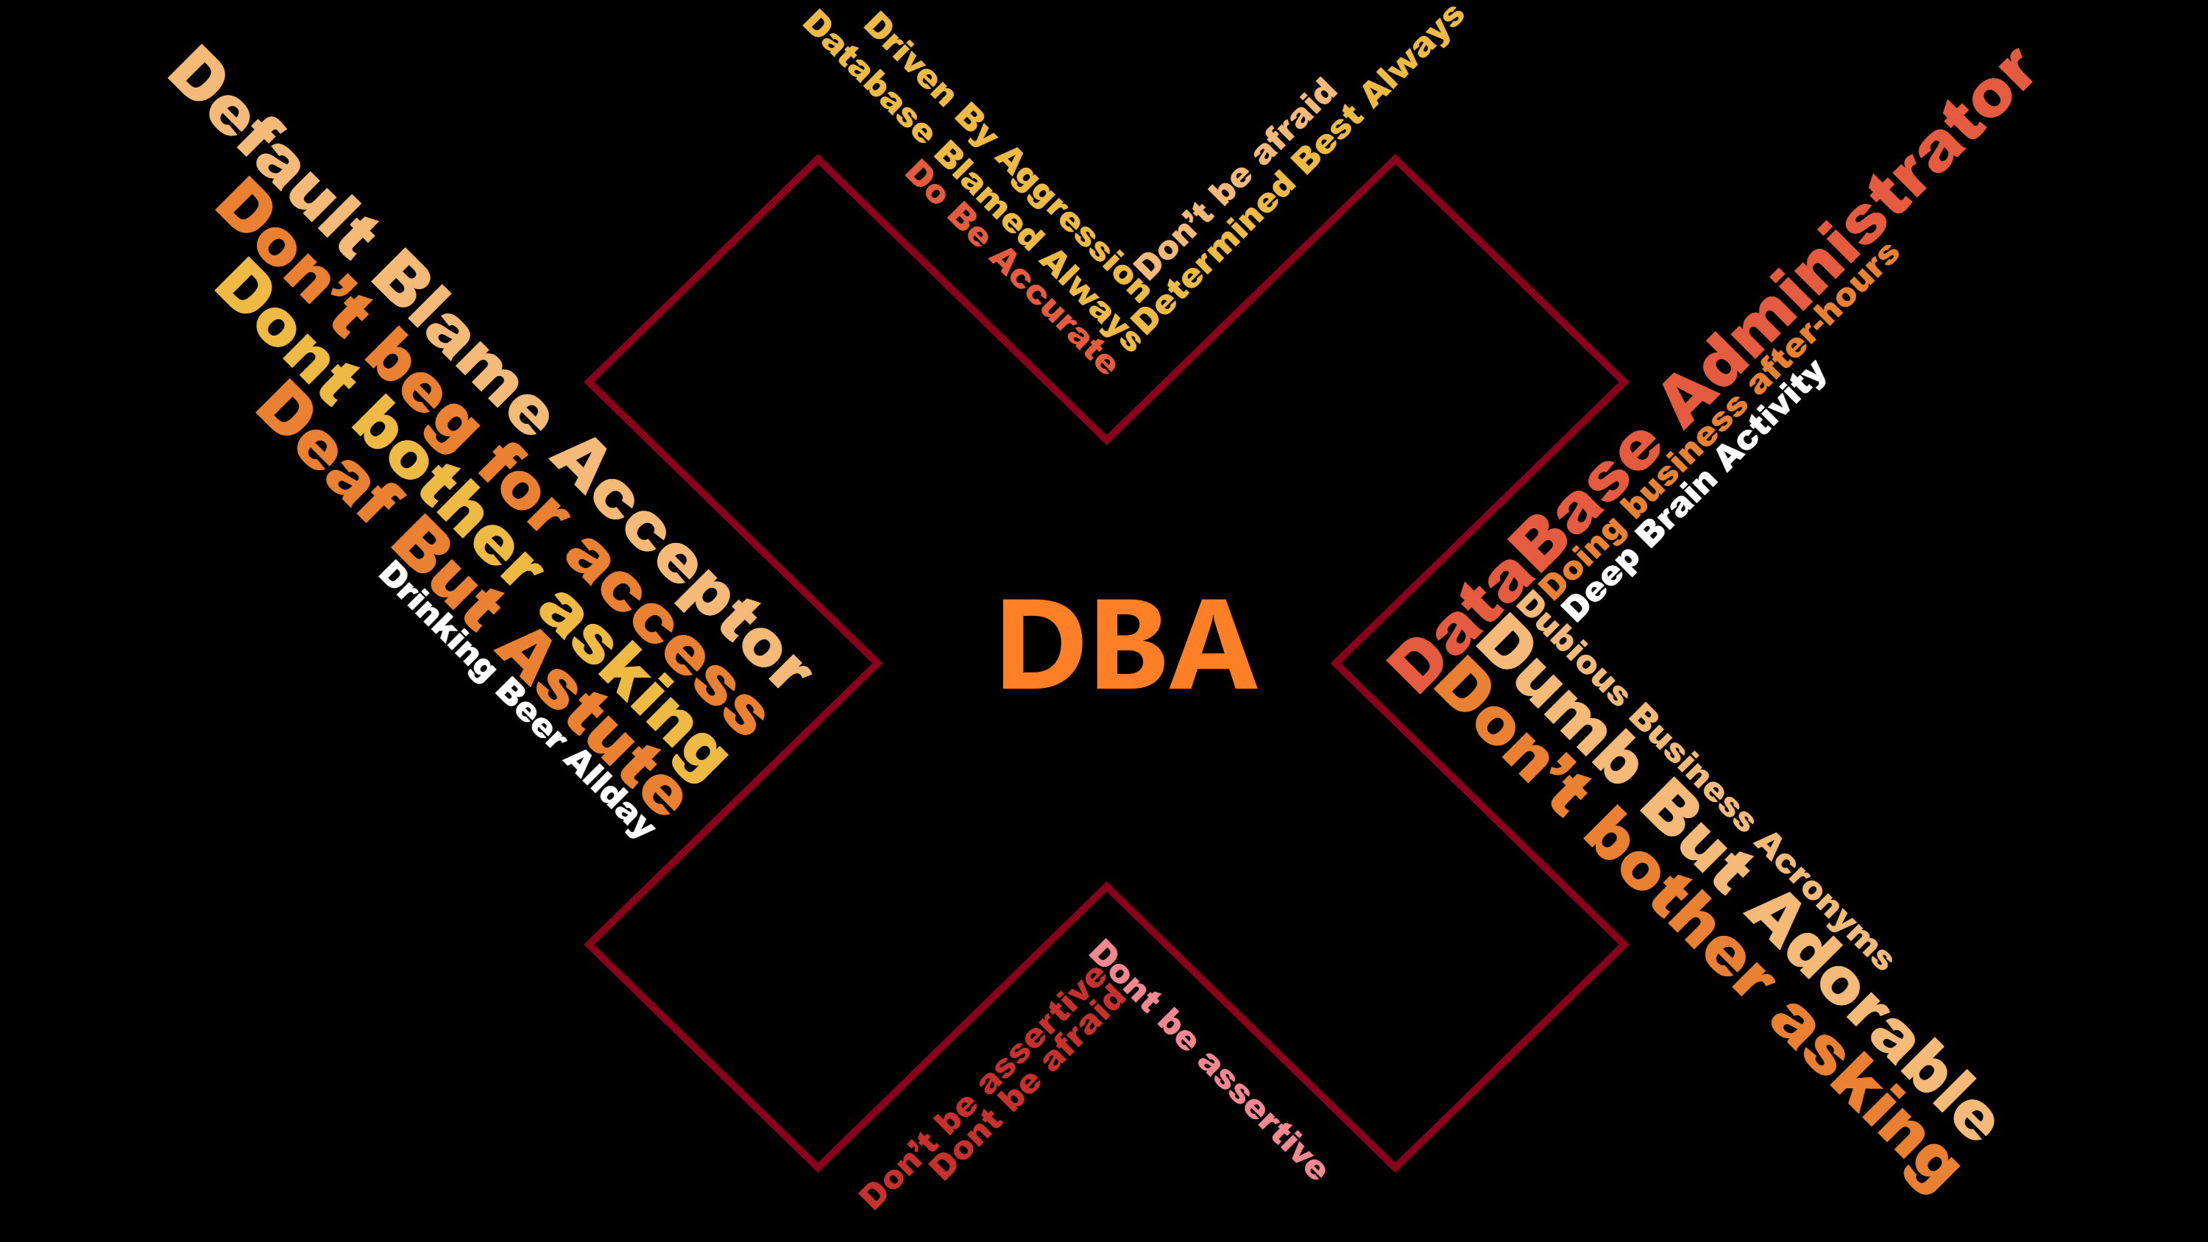

Slide 29

Let Your Mind Run Free
Photo by Alice Donovan Rouse on Unsplash

Slide 30
Some Ideas
Run Books
Training
Incident response templates – for Service Desk and for DBAs
Templates for common functions
Demoing
Share Data with a 3rd Party

Slide 32
Rob Sewell
@SQLDBAWithBeard
mrrobsewell@outlook.com
beard.media/book

